Slide 1
New Hampshire Traffic Stops
Jiale Zhao, Mark McComiskey, Viraj Salvi, and Devan Miller

Slide 2
Are “Teen drivers” treated differently than other age classes of drivers?
Dimensions for Analysis:
Gender
Monthly Trend of Stops
Violation Type
County
TBD
Filters:
Removed N/As in regard to “driver_age”
Only stops which occurred in 2015
Reference Guide for Age Classes:
Class | Age Range
Teenagers | 15 - 21
Millennials | 22 - 37
Gen X | 38 - 53
Boomers | 54 - 72
Silent | >72
*Source: Pew Research Center

Slide 3
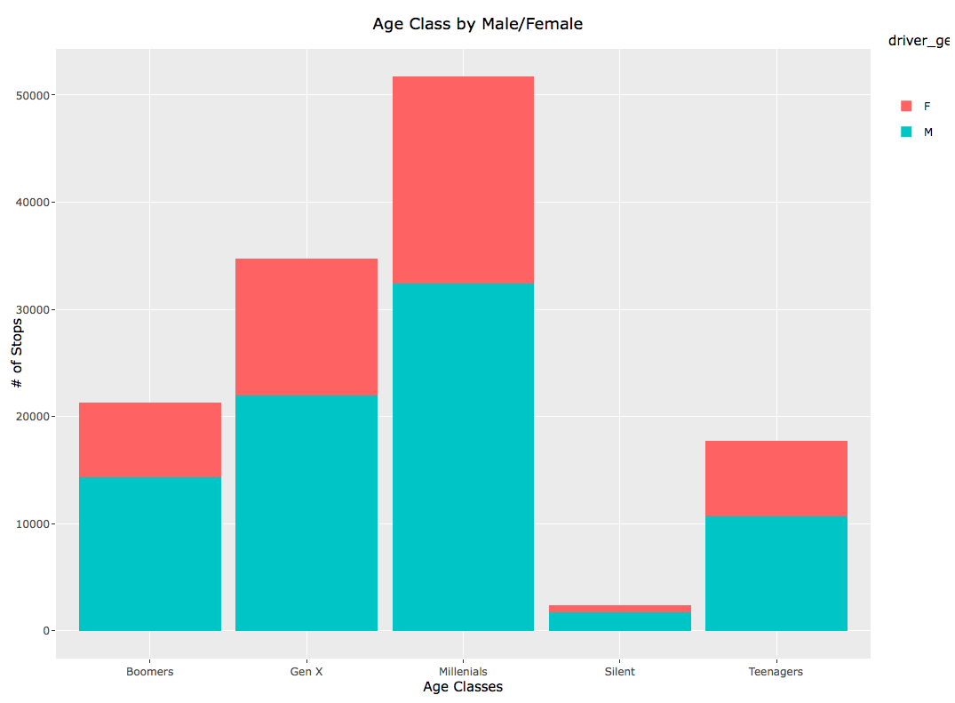
Males and Females in Each Age Group
Simple bar graph with population against age classes with male and female filters.
Each Age classes have more male population.
Millennials group have the highest number of ratio followed by GenX.
So the Millennials are the largest population group in these NH traffic dataset.

Slide 4
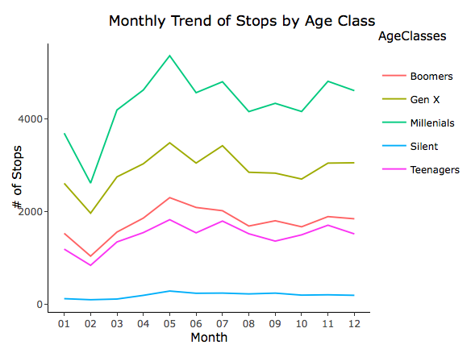
Monthly Trend of Traffic Stops by Age Class
Overall teens seem to follow the trend displayed by all age classes excluding Silent which remained fairly flat throughout the year
The primary take away from this graph is really the uptick in traffic stops ranging from February to May

Slide 5
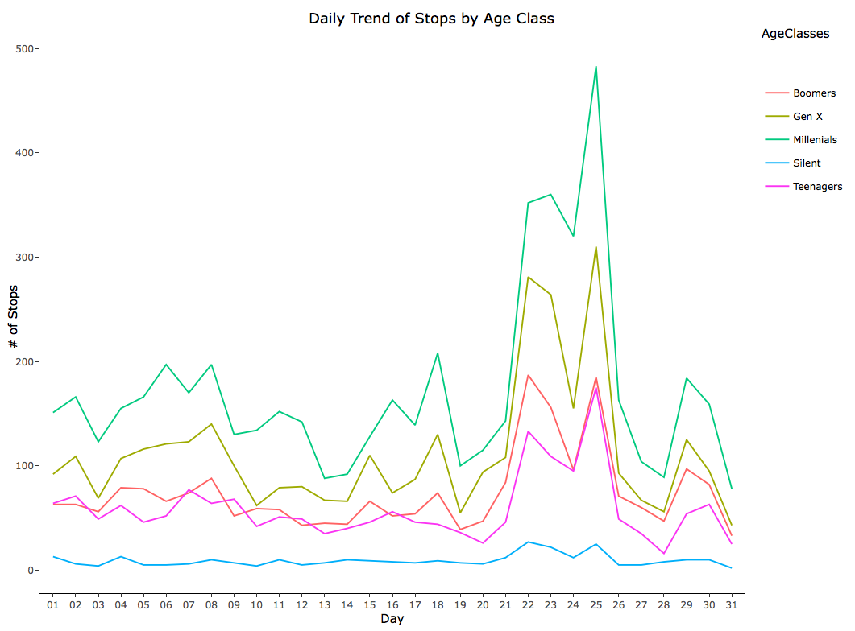
Daily Trend of Traffic Stops by Age Class for May
Teens still seem to follow the overall trend of traffic stops throughout the month of May
More specifically we see the spike toward the end of the month between the 21st - 26th

Slide 6
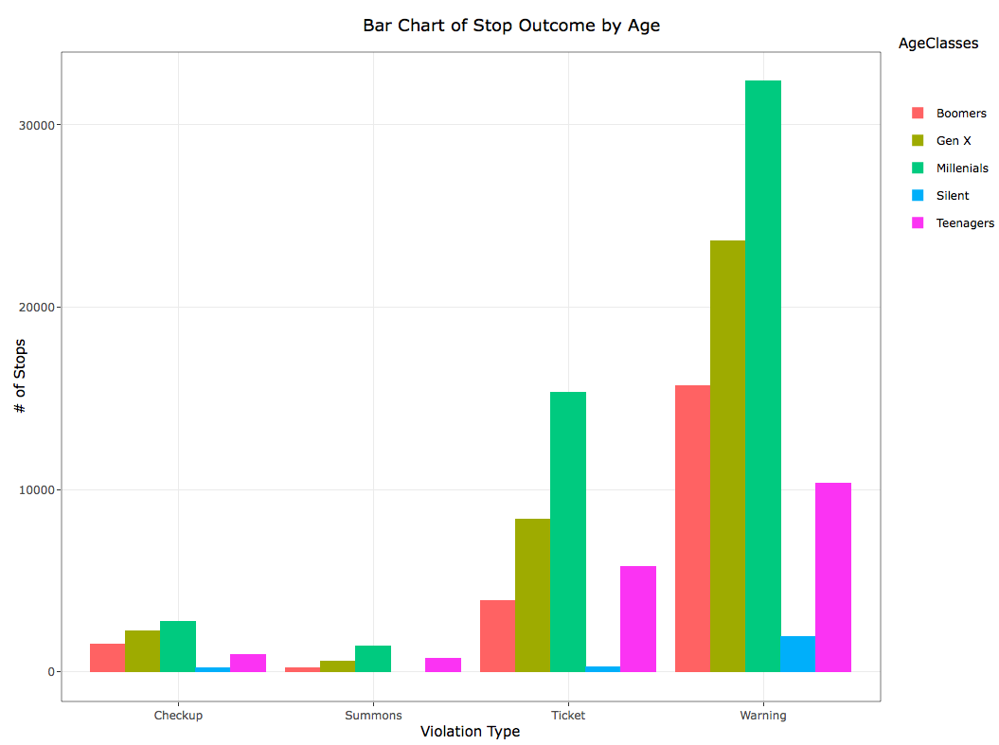
Teens vs. Other Age Groups: Stop Outcomes
Expected to see teens receiving more warnings than the rest of the population
Expected to see the rest of the population receive less warnings and more tickets than teens
Millenials have the highest number of warnings and tickets
Notes:
Devan

Slide 7
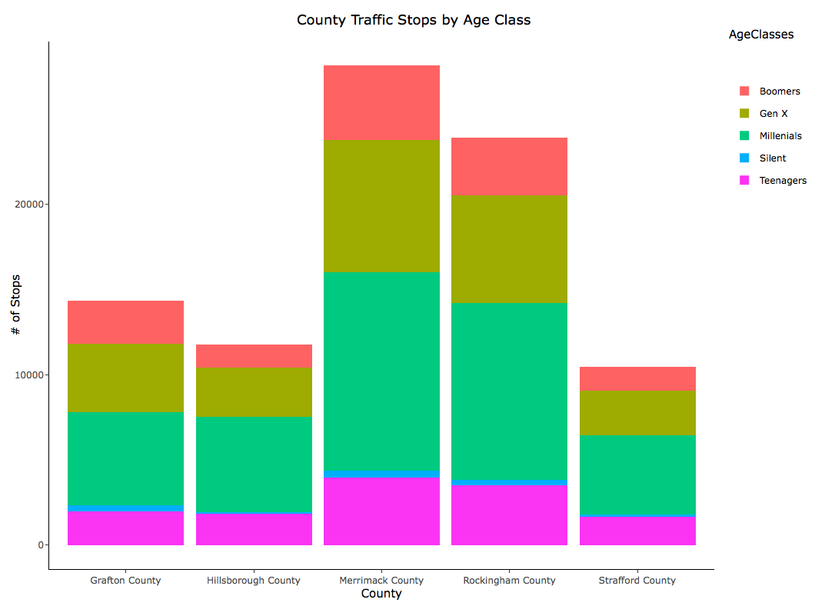
County & Teen and Adult
The overall data in this chart shows that:
1.Millennials, 2. is GenX, 3.Teenager and boomers close to each other, 5. silent is the least.
The top 5 place where people stopped is Merrimack, Rockingham, Grafton, Hillsborough, , Strafford.

Slide 8

Conclusion
From our analysis, it does not seem that teenagers in New Hampshire are treated differently than other age groups
Taking it further
Additional analysis could be done to find percentages and variances of age groups
Order the columns from “teens”-”Silent” and remain consistent throughout graphs
Compare to datasets from other states
Do other states have as much missing data for age?
Are trends the same for age groups in other states?
Notes:
Devan

